Slide 1
OLA DATA ANALYSIS PROJECT
JIYA JOSHI

Slide 2
INTRODUCTION
To conduct a meaningful analysis of Ola's ride data in Delhi, we focused on ride patterns, user behavior, operational efficiency, and pricing dynamics specific to the city. Delhi, being one of the busiest metropolitan areas in India, presents unique transportation challenges and opportunities, making it an ideal case for ride-hailing data analysis.

Slide 3
SQL QUERIES:
To analyze Ola ride data specifically in Delhi, we use SQL queries to extract, summarize, and visualize patterns hidden in the data.
1. Retrieve all successful bookings:
2. Find the average ride distance for each vehicle type:
3. Get the total number of cancelled rides by customers:
4. List the top 5 customers who booked the highest number of rides:
5. Get the number of rides cancelled by drivers due to personal and car-related issues:
6. Find the maximum and minimum driver ratings for Prime Sedan bookings:
7. Retrieve all rides where payment was made using UPI:
8. Find the average customer rating per vehicle type:
9. Calculate the total booking value of rides completed successfully:
10. List all incomplete rides along with the reason

Slide 4
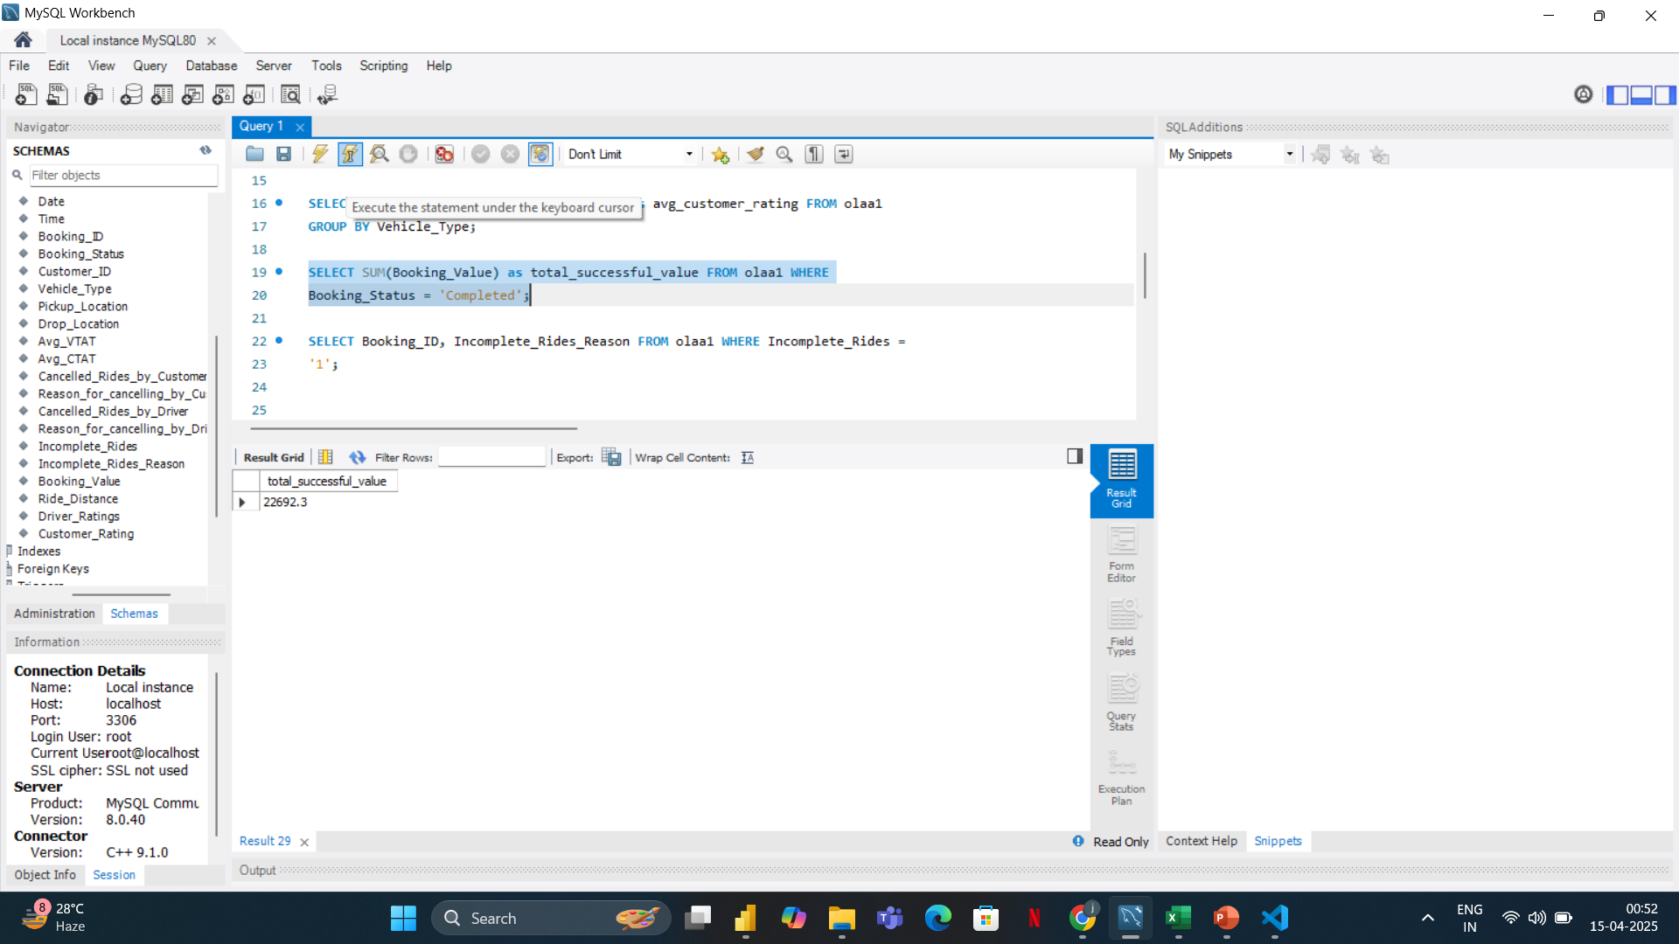
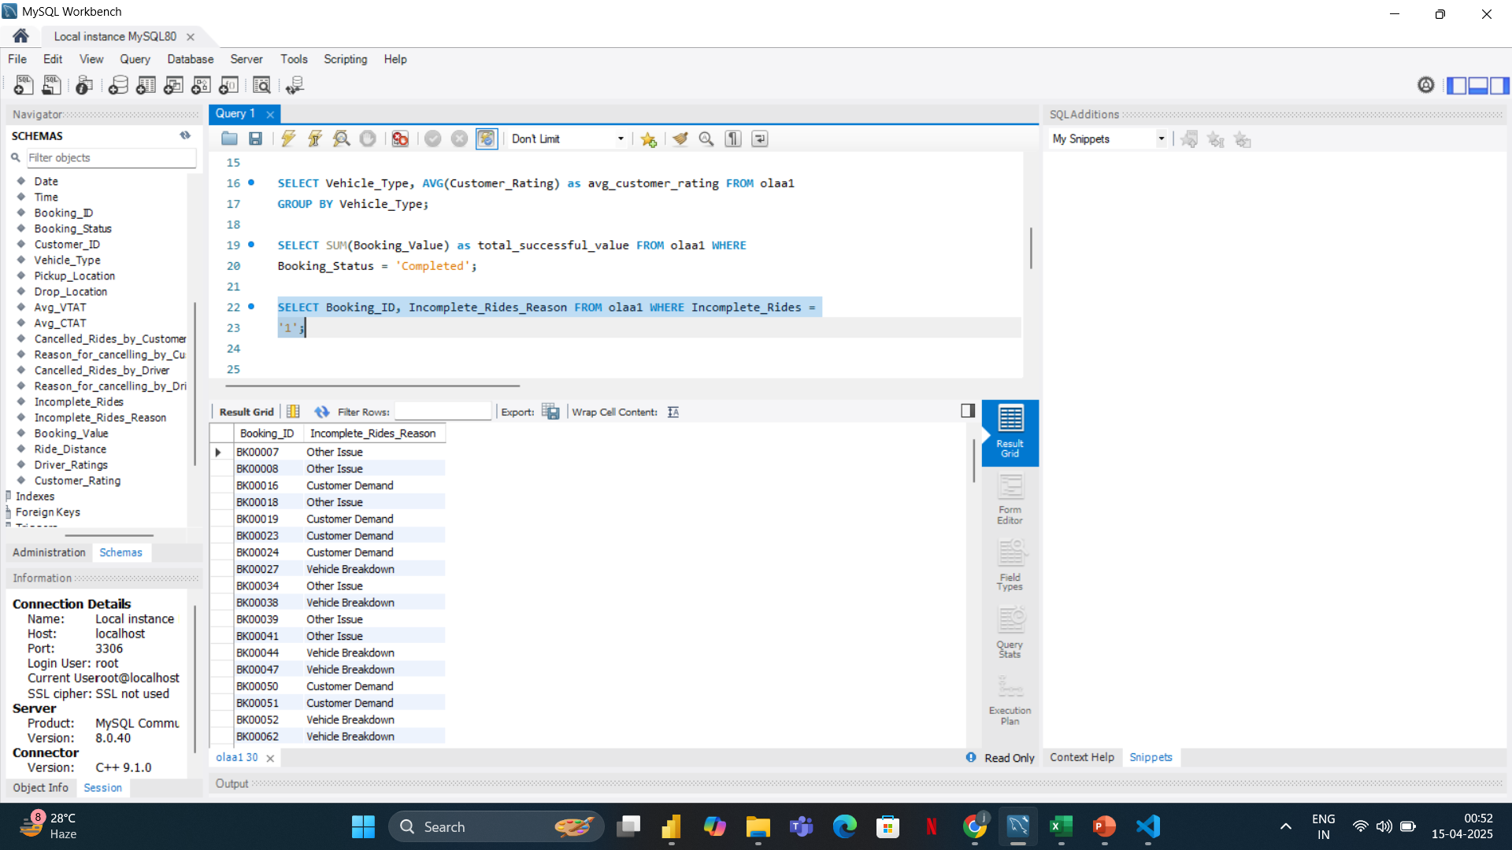

Slide 5
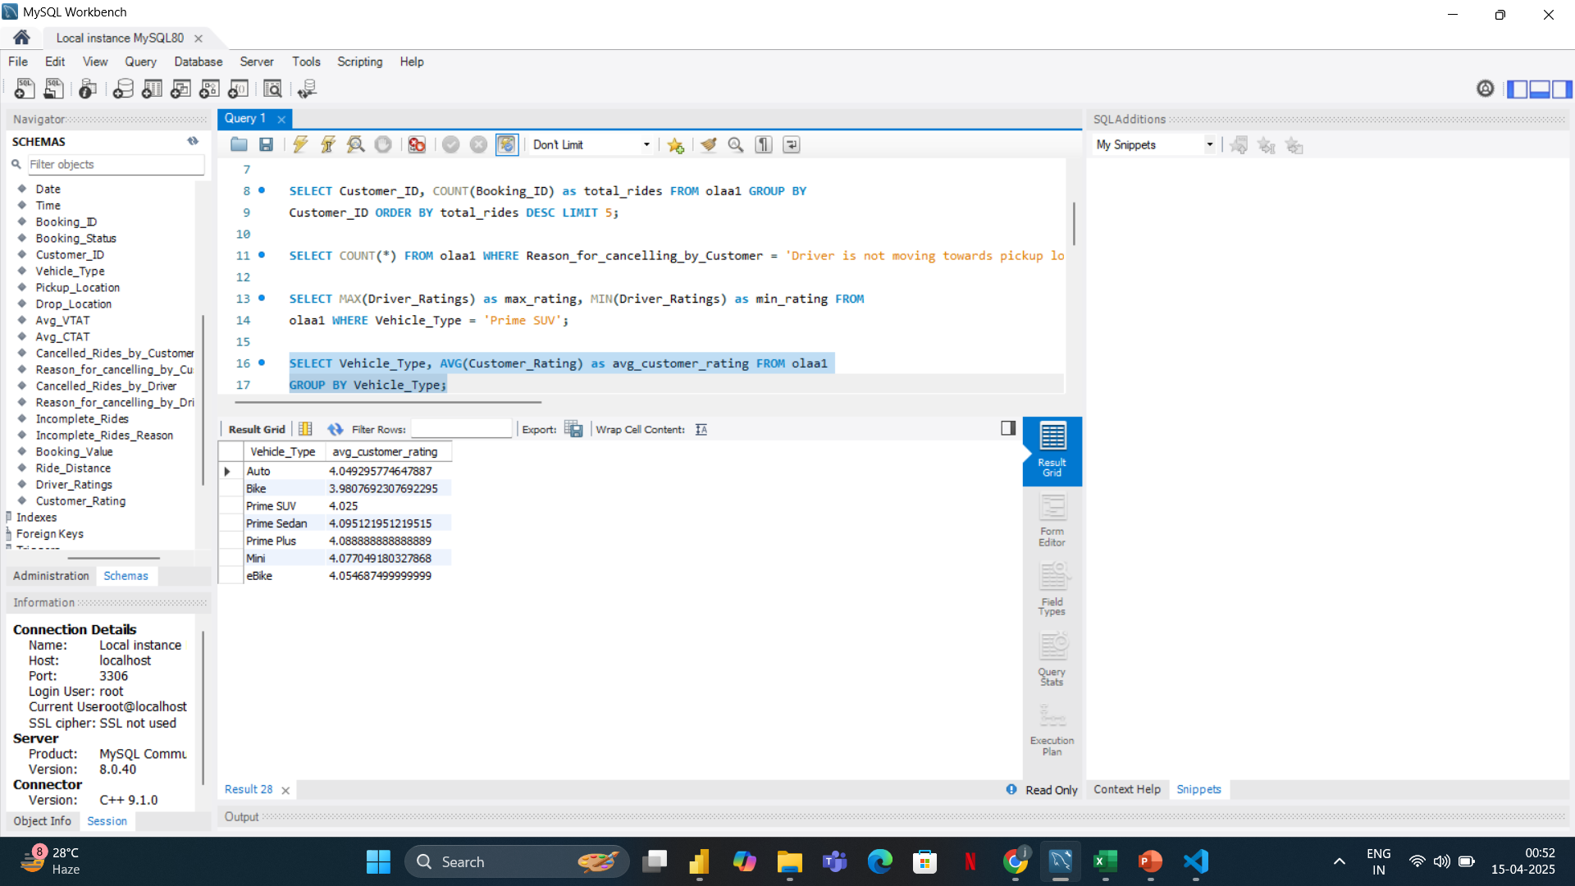
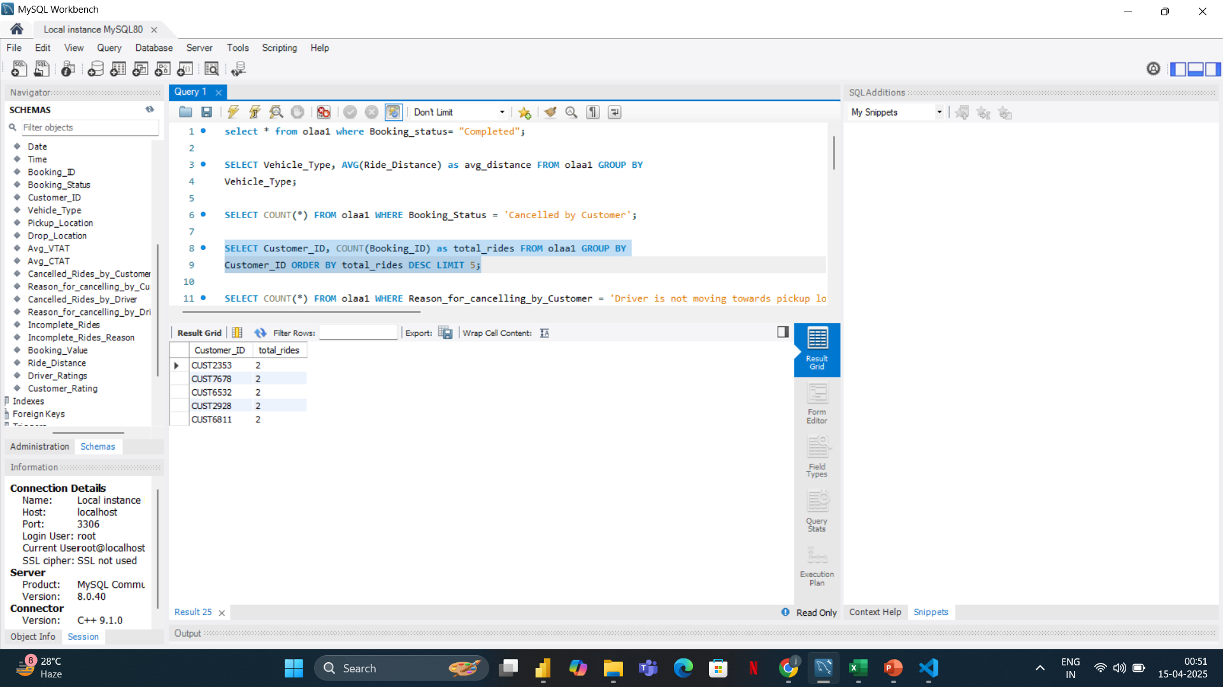
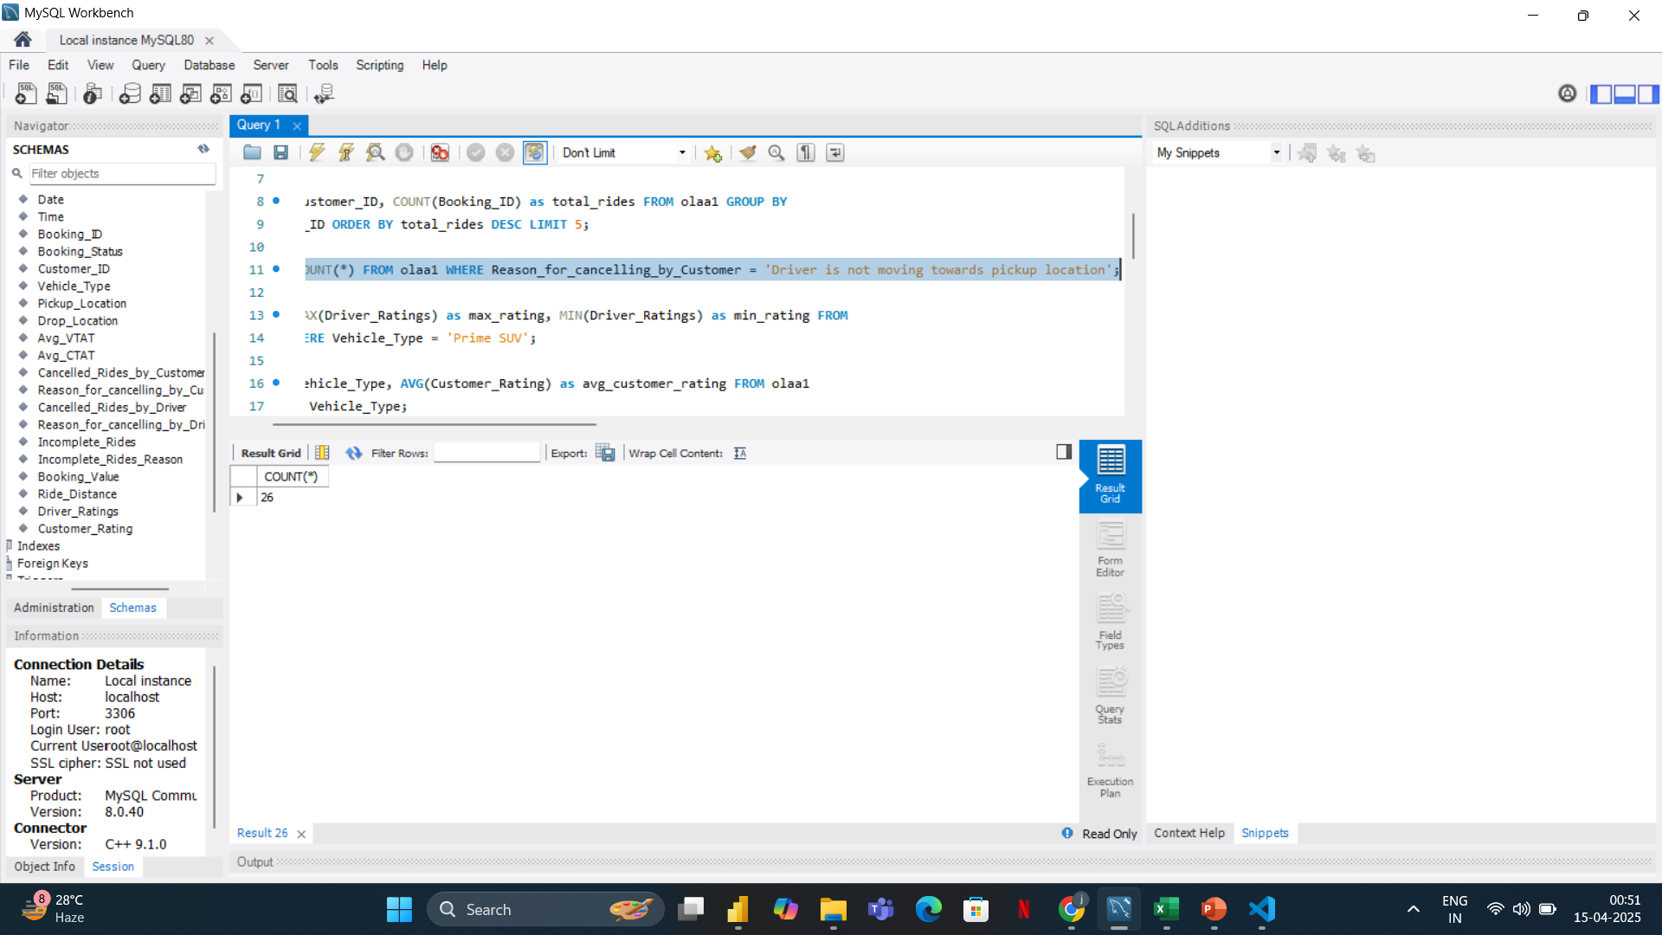
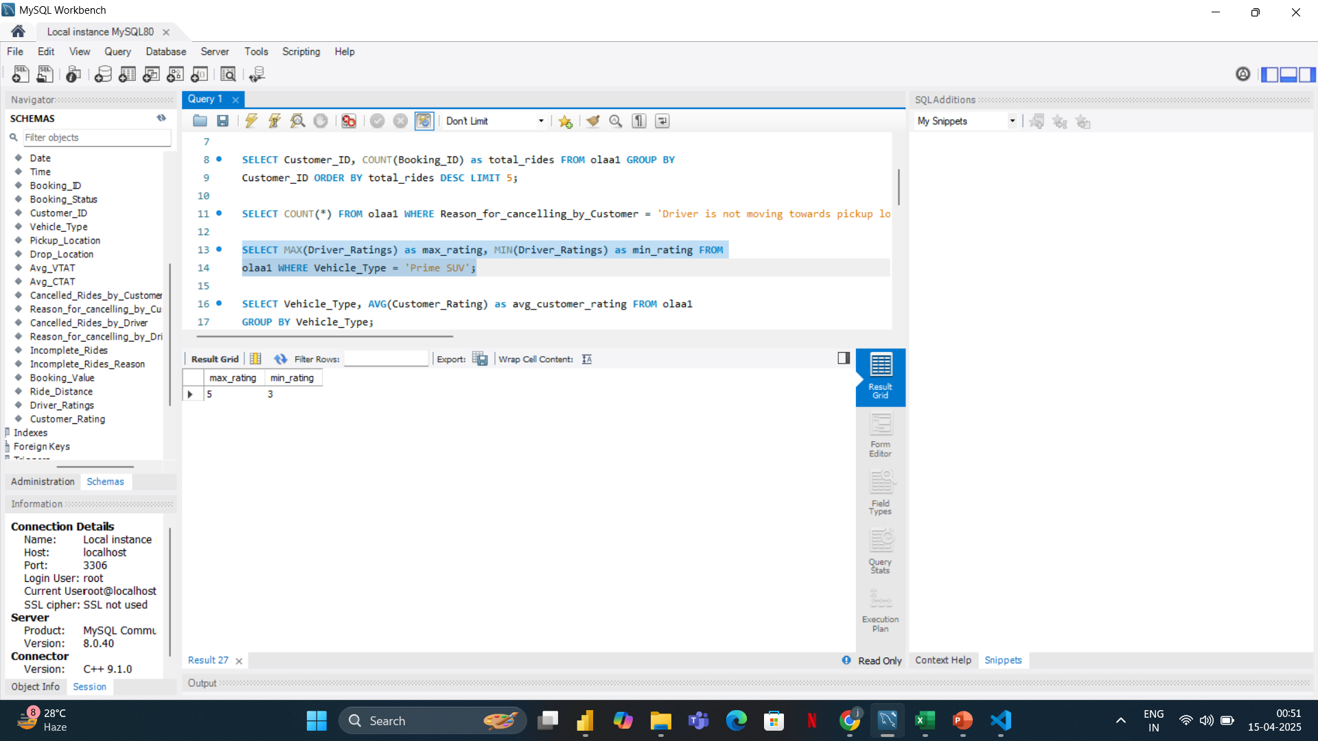

Slide 6
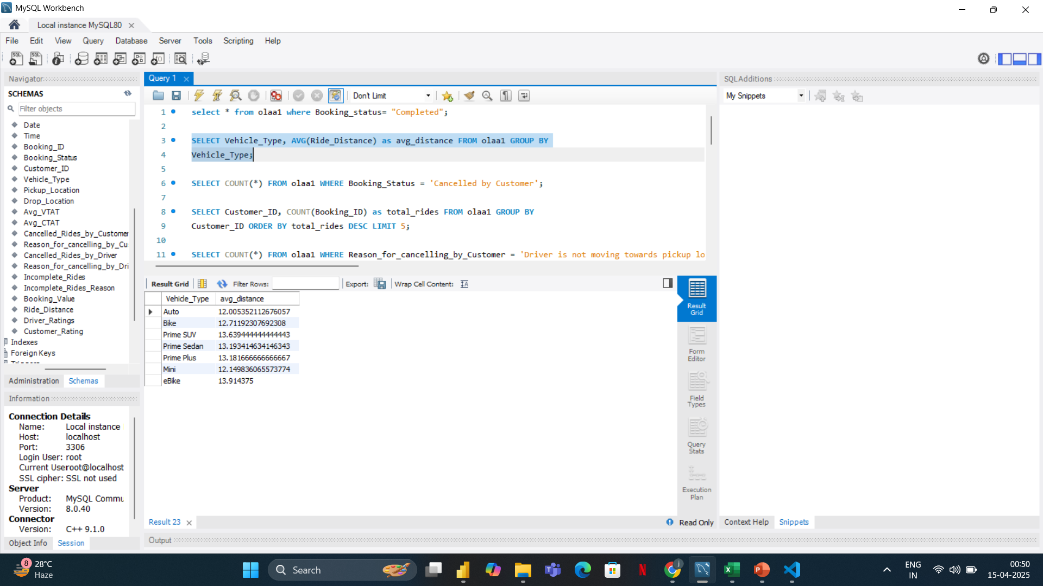
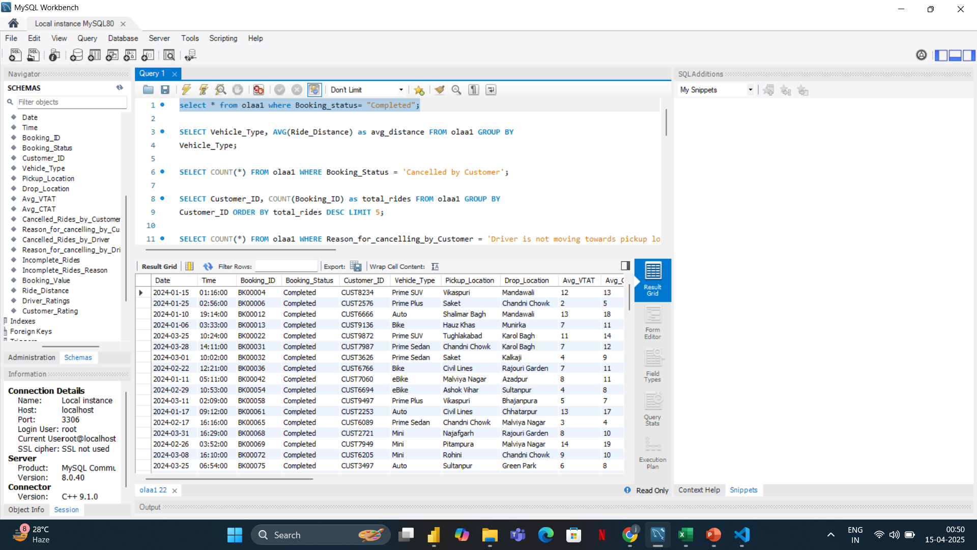
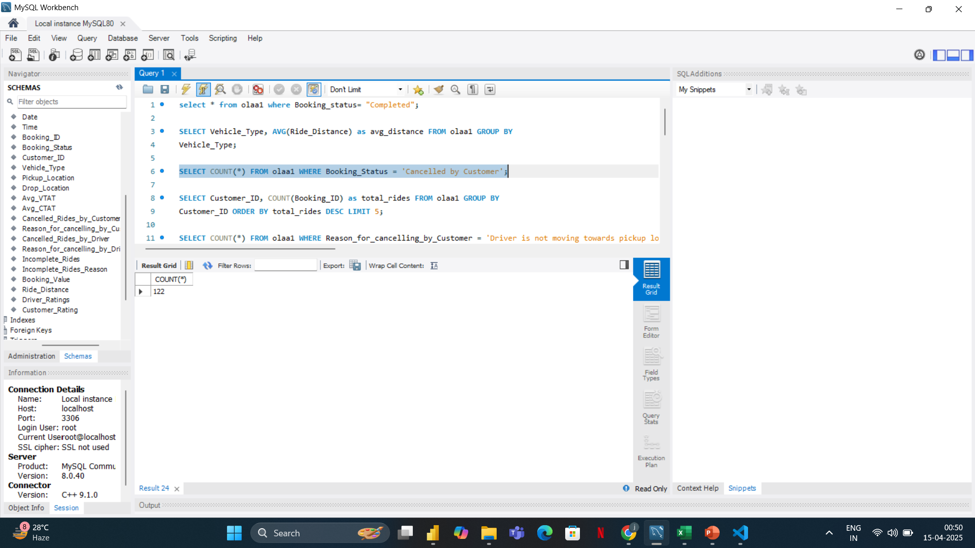

Slide 7
POWER BI
Power BI is a powerful business intelligence and data visualization tool developed by Microsoft. It helps turn raw data into meaningful insights through interactive dashboards, charts, and reports.
It empowers users to make faster, data-driven decisions through beautiful, interactive visualizations and dashboards.

Slide 8
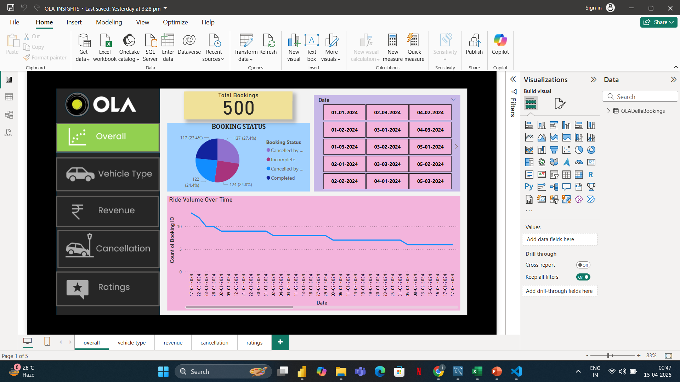

Slide 9
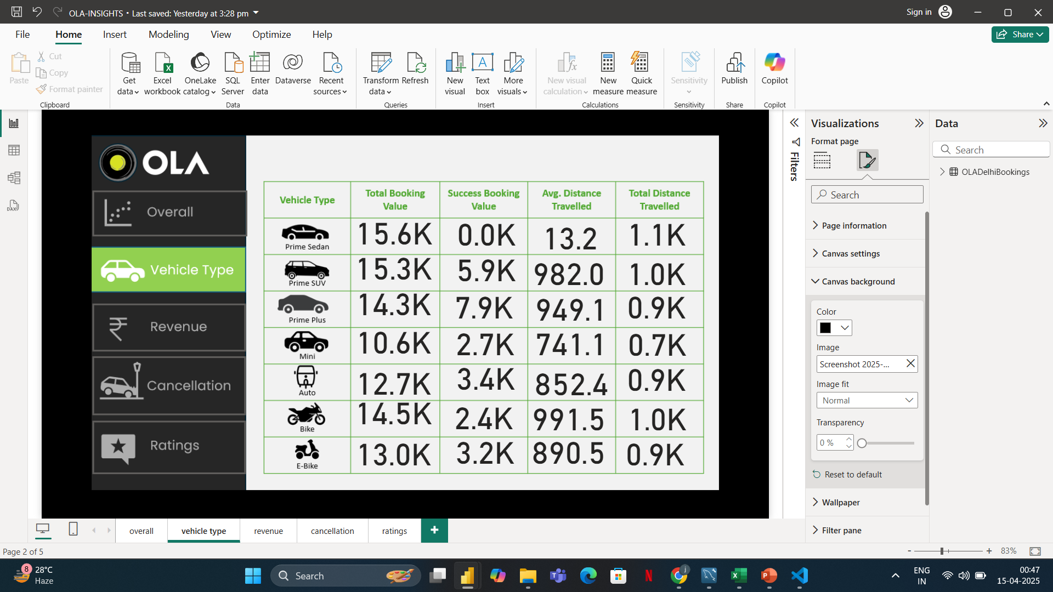

Slide 10
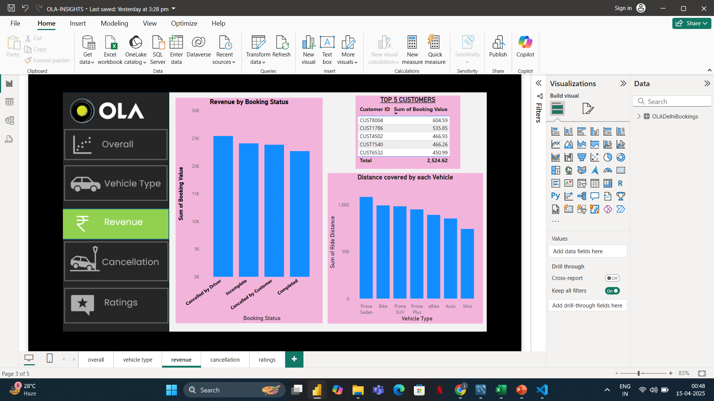

Slide 11
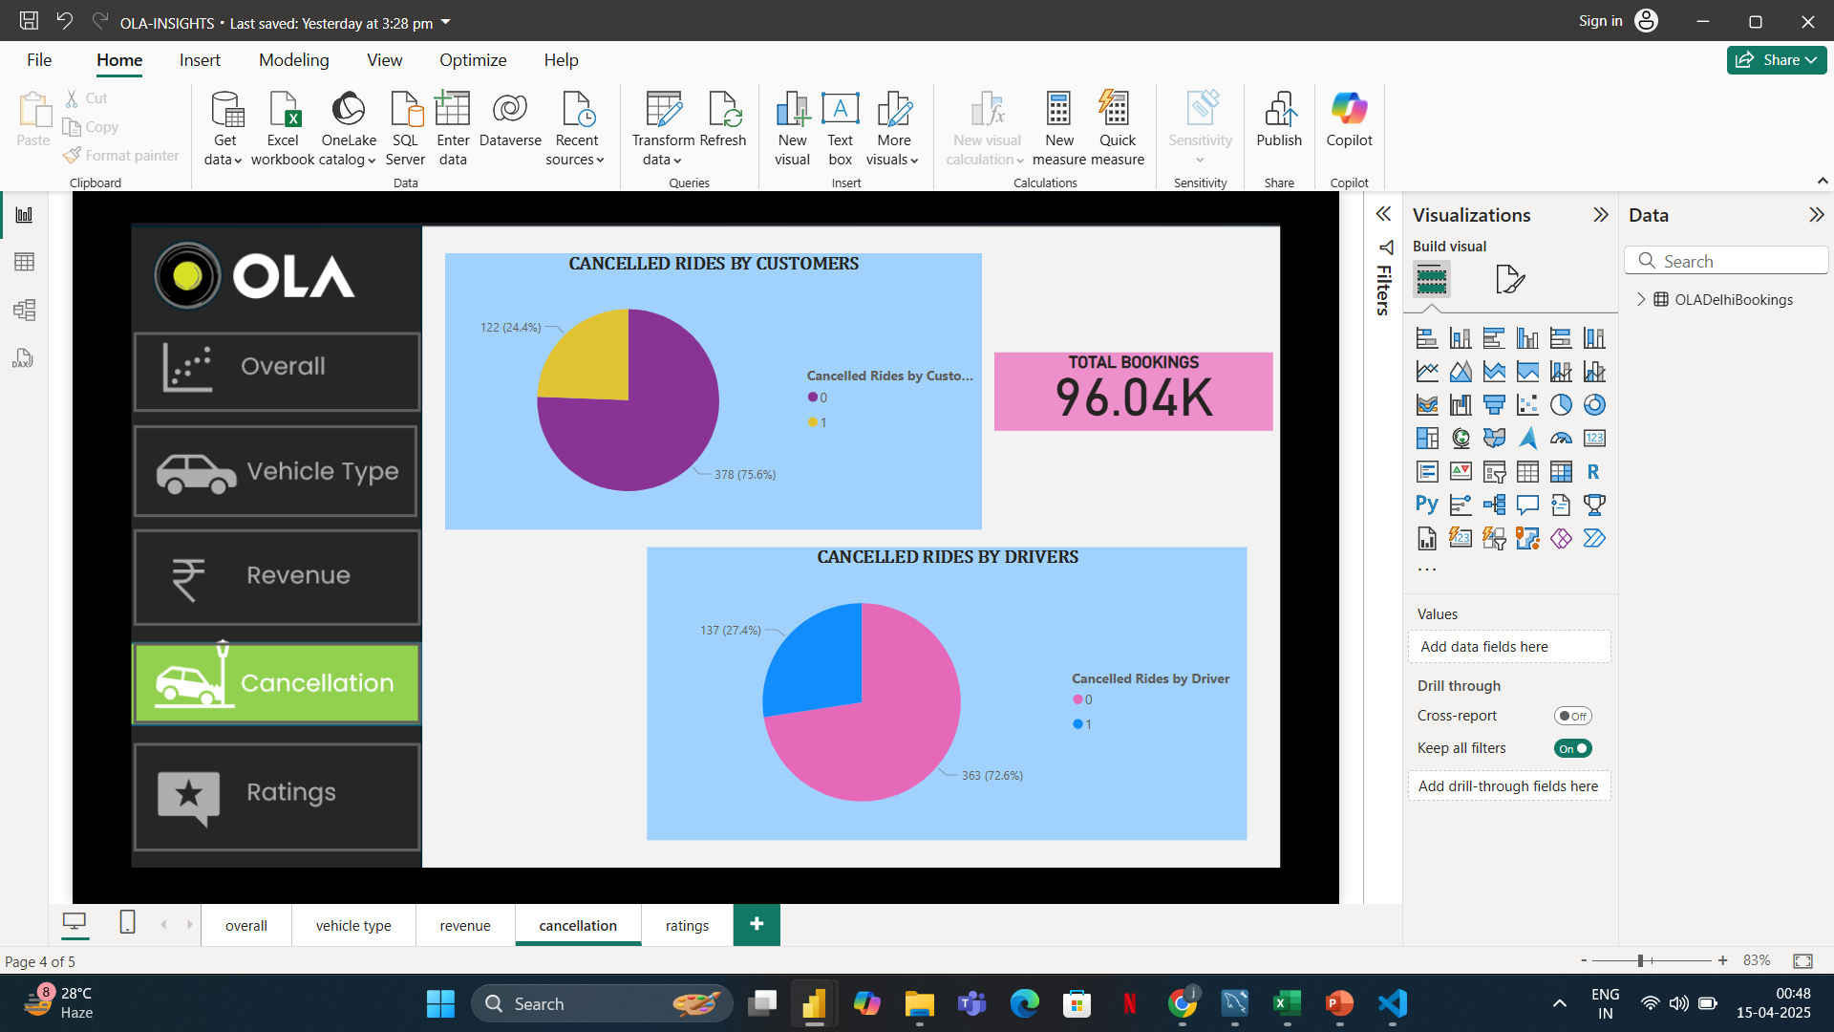

Slide 12
